Slide 1
4
Control Statements:
Part 1

Slide 2
Let’s all move one place on.
  Lewis Carroll
The wheel is come full circle.
  William Shakespeare
How many apples fell on Newton’s head before he took the hint!
  Robert Frost
All the evolution we know of proceeds from the vague to the definite.
  Charles Sanders Peirce

Slide 3
OBJECTIVES
In this chapter you will learn:
Basic problem-solving techniques.
To develop algorithms through the process of top-down, stepwise refinement.
To use the if and if...else selection statements to choose among alternative actions.
To use the while repetition statement to execute statements in a program repeatedly.
Counter-controlled repetition and sentinel-controlled repetition.
To use the increment, decrement and assignment operators.

Slide 4
4.4 Control Structures
Sequential execution
  Statements executed in sequential order
Transfer of control
  Next statement executed is not the next one in sequence
Structured programming
  Eliminated goto statements

Slide 5
4.4 Control Structures (Cont.)
Only three control structures needed
  No goto statements
  Demonstrated by Böhm and Jacopini
  Three control structures
    Sequence structure
      Programs executed sequentially by default
    Selection structures
      if, if…else, switch
    Repetition structures
      while, do…while, for

Slide 6
4.4 Control Structures (Cont.)
Single-entry/single-exit control statements
  Three types of control statements
    Sequence statement
    Selection statements
    Repetition statements
  Combined in one of two ways
    Control statement stacking
      Connect exit point of one to entry point of the next
    Control statement nesting

Slide 7
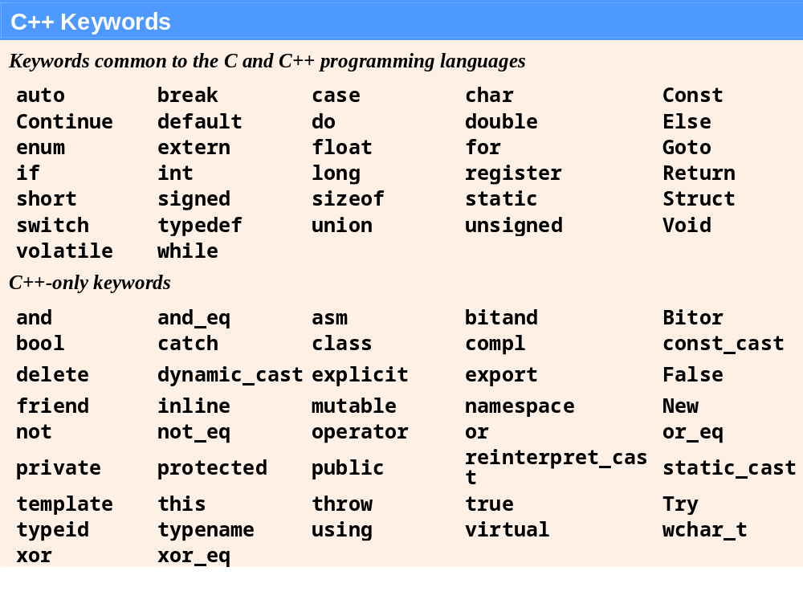
Fig. 4.3 | C++ keywords.

Slide 8
Common Programming Error 4.1
Using a keyword as an identifier is a syntax error.

Slide 9
Common Programming Error 4.2
Spelling a keyword with any uppercase letters is a syntax error. All of C++’s keywords contain only lowercase letters.

Slide 10
Software Engineering Observation 4.1
Any C++ program we will ever build can be constructed from only seven different types of control statements (sequence, if, if... else, switch, while, do... while and for) combined in only two ways (control-statement stacking and control-statement nesting).

Slide 11
4.5 if Selection Statement (Cont.)
Selection statements (Cont.)
  Translation into C++
    if ( grade >= 60 )
    cout << "Passed";
  Any expression can be used as the condition
    If it evaluates to false, it is treated as false
Diamond symbol in UML modeling
  Indicates decision is to be made
  Contains guard conditions
    Test condition
    Follow correct path

Slide 12
Good Programming Practice 4.1
Consistently applying reasonable indentation conventions throughout your programs greatly improves program readability. We suggest three blanks per indent. Some people prefer using tabs but these can vary across editors, causing a program written on one editor to align differently when used with another.

Slide 13
Portability Tip 4.1
For compatibility with earlier versions of C, which used integers for Boolean values, the bool value true also can be represented by any nonzero value (compilers typically use 1) and the bool value false also can be represented as the value zero.

Slide 14
4.6 if…else Double-Selection Statement
if
  Performs action if condition true
if…else
  Performs one action if condition is true, a different action if it is false
Pseudocode
  If student’s grade is greater than or equal to 60
  print “Passed”
  Else
  print “Failed”
C++ code
  if ( grade >= 60 )
  cout << "Passed";
  else
  cout << "Failed";

Slide 15
4.6 if…else Double-Selection Statement (Cont.)
Ternary conditional operator (?:)
  Three arguments (condition, value if true, value if false)
Code could be written:
  cout << ( grade >= 60 ? “Passed” : “Failed” );
Condition
Value if true
Value if false

Slide 16
Error-Prevention Tip 4.1
To avoid precedence problems (and for clarity), place conditional expressions (that appear in larger expressions) in parentheses.

Slide 17
4.6 if…else Double-Selection Statement (Cont.)
Nested if…else statements (Cont.)
  Written In C++
    if ( studentGrade >= 90 )
    cout << "A";
    else
    if (studentGrade >= 80 )
    cout << "B";
    else
    if (studentGrade >= 70 )
    cout << "C";
    else
    if ( studentGrade >= 60 )
    cout << "D";
    else
    cout << "F";

Slide 18
Performance Tip 4.1
A nested if...else statement can perform much faster than a series of single-selection if statements because of the possibility of early exit after one of the conditions is satisfied.

Slide 19
Performance Tip 4.2
In a nested if... else statement, test the conditions that are more likely to be true at the beginning of the nested if...else statement. This will enable the nested if...else statement to run faster and exit earlier than testing infrequently occurring cases first.

Slide 20
4.6 if…else Double-Selection Statement (Cont.)
Dangling-else problem
  Compiler associates else with the immediately preceding if
  Example
    if ( x > 5 )
    if ( y > 5 )
    cout << "x and y are > 5";
    else
    cout << "x is <= 5";
  Compiler interprets as
    if ( x > 5 )
    if ( y > 5 )
    cout << "x and y are > 5";
    else
    cout << "x is <= 5";

Slide 21
4.6 if…else Double-Selection Statement (Cont.)
Dangling-else problem (Cont.)
  Rewrite with braces ({})
    if ( x > 5 )
    {
    if ( y > 5 )
    cout << "x and y are > 5";
    }
    else
    cout << "x is <= 5";
      Braces indicate that the second if statement is in the body of the first and the else is associated with the first if statement

Slide 22
4.6 if…else Double-Selection Statement (Cont.)
Compound statement
  Also called a block
    Set of statements within a pair of braces
    Used to include multiple statements in an if body
  Example
    if ( studentGrade >= 60 )
    cout << "Passed.\n";
    else
    {
    cout << "Failed.\n";
    cout << "You must take this course again.\n";
    }
  Without braces,
  cout << "You must take this course again.\n";
  always executes

Slide 23
Software Engineering Observation 4.2
A block can be placed anywhere in a program that a single statement can be placed.

Slide 24
Good Programming Practice 4.4
Always putting the braces in an if...else statement (or any control statement) helps prevent their accidental omission, especially when adding statements to an if or else clause at a later time. To avoid omitting one or both of the braces, some programmers prefer to type the beginning and ending braces of blocks even before typing the individual statements within the braces.

Slide 25
4.6 if…else Double-Selection Statement (Cont.)
Empty statement
  A semicolon (;) where a statement would normally be
  Performs no action
  Also called a null statement

Slide 26
Common Programming Error 4.4
Placing a semicolon after the condition in an if statement leads to a logic error in single-selection if statements and a syntax error in double-selection if...else statements (when the if part contains an actual body statement).

Slide 27
4.8 Formulating Algorithms: Counter-Controlled Repetition (Cont.)
Uninitialized variables
  Contain “garbage” (or undefined) values
Notes on integer division and truncation
  Integer division
    When dividing two integers
    Performs truncation
      Fractional part of the resulting quotient is lost

Slide 28
Common Programming Error 4.7
Assuming that integer division rounds (rather than truncates) can lead to incorrect results. For example, 7 ÷ 4, which yields 1.75 in conventional arithmetic, truncates to 1 in integer arithmetic, rather than rounding to 2.

Slide 29
Common Programming Error 4.8
Using a loop’s counter-control variable in a calculation after the loop often causes a common logic error called an off-by-one-error. In a counter-controlled loop that counts up by one each time through the loop, the loop terminates when the counter’s value is one higher than its last legitimate value (i.e., 11 in the case of counting from 1 to 10).

Slide 30
Error-Prevention Tip 4.3
When performing division by an expression whose value could be zero, explicitly test for this possibility and handle it appropriately in your program (such as by printing an error message) rather than allowing the fatal error to occur.

Slide 31
4.9 Formulating Algorithms: Sentinel-Controlled Repetition (Cont.)
Floating-point numbers
  A real number with a decimal point
  C++ provides data types float and double
    double numbers can have larger magnitude and finer detail
      Called precision
    Floating-point constant values are treated as double values by default
  Floating-point values are often only approximations

Slide 32
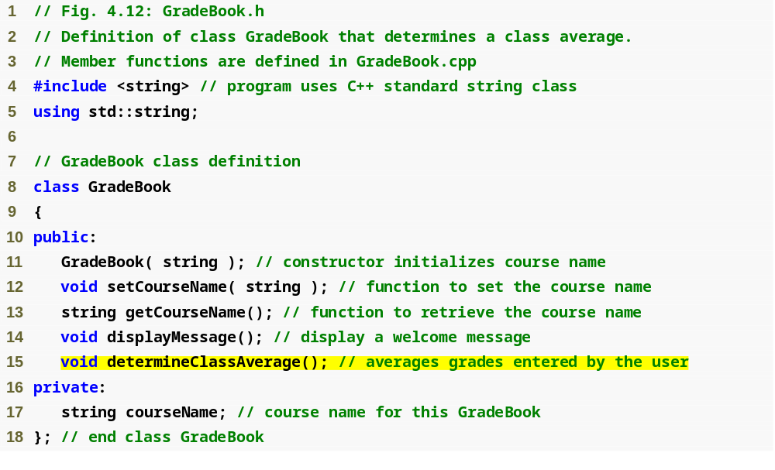
Outline
fig04_12.cpp
(1 of 1)

Slide 33
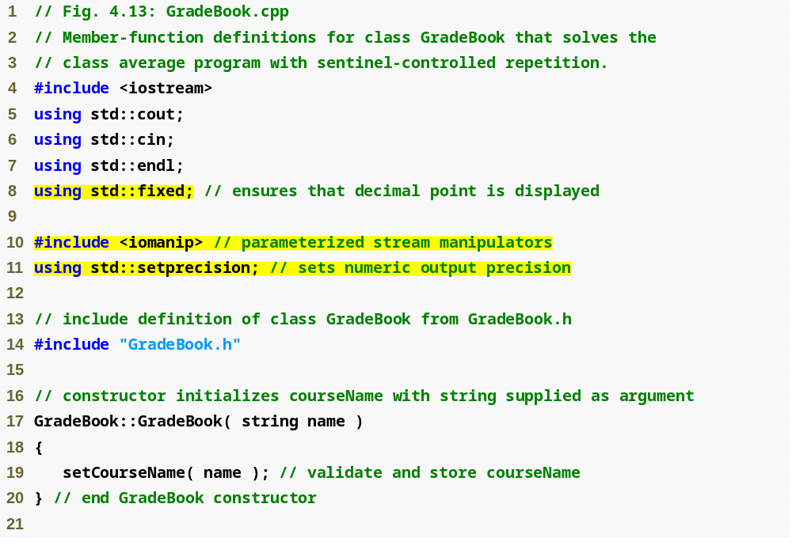
Outline
fixed forces output to print in fixed point format (not scientific notation) and forces trailing zeros and decimal point to print
fig04_13.cpp
(1 of 4)
steprecision stream manipulator (in header <iomanip>) sets numeric output precision

Slide 34
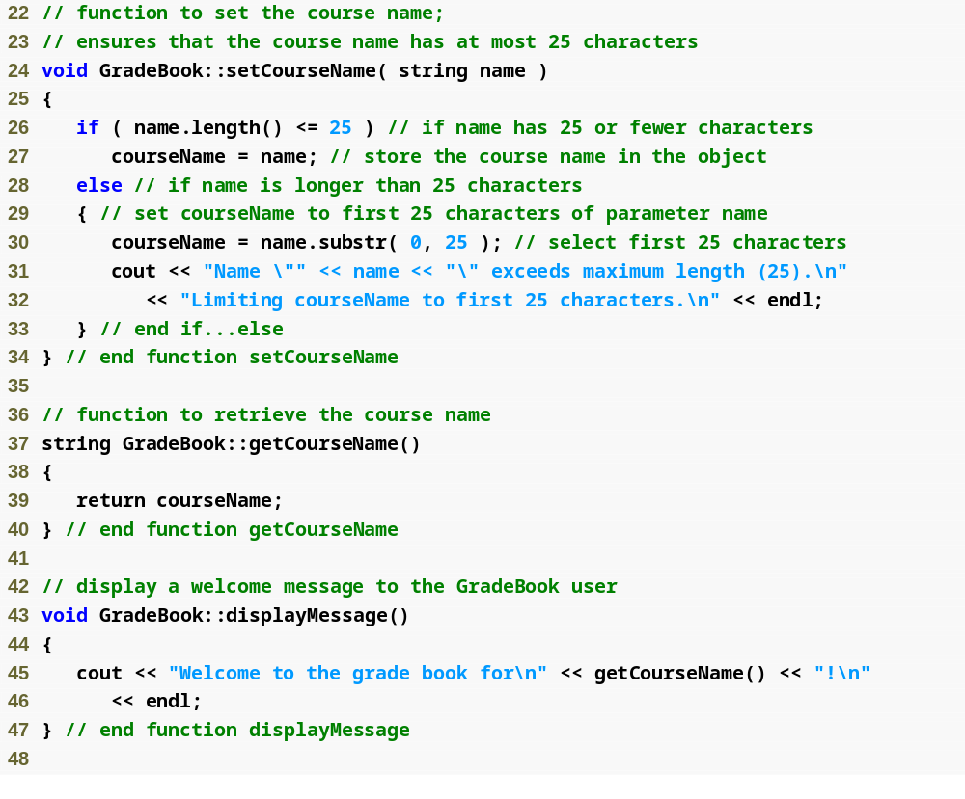
Outline
fig04_13.cpp
(2 of 4)

Slide 35
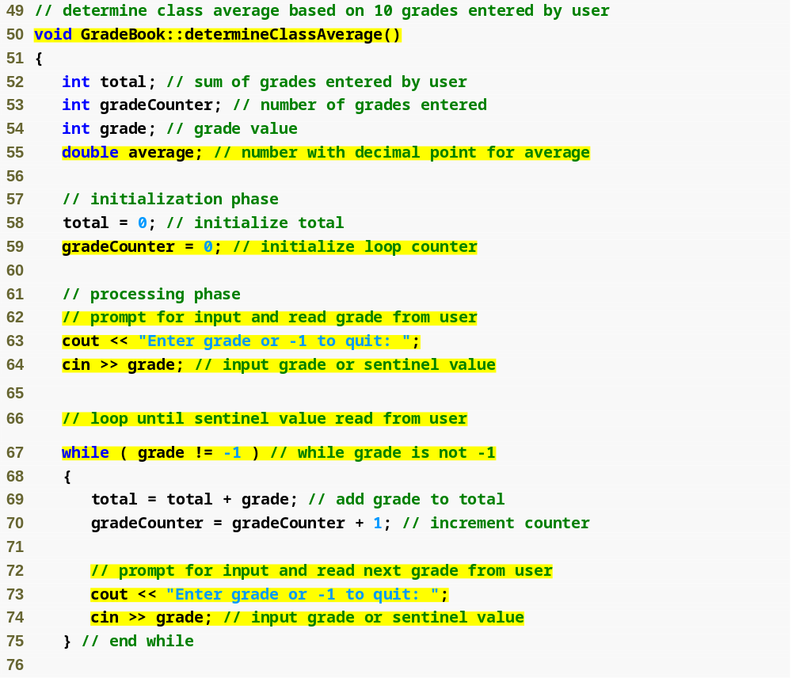
Outline
Function determineClassAverage implements the class average algorithm described by the pseudocode
fig04_13.cpp
(3 of 4)
Declare local int variables total, gradeCounter and grade and double variable average
while loop iterates as long as grade does not equal the sentinel value -1

Slide 36
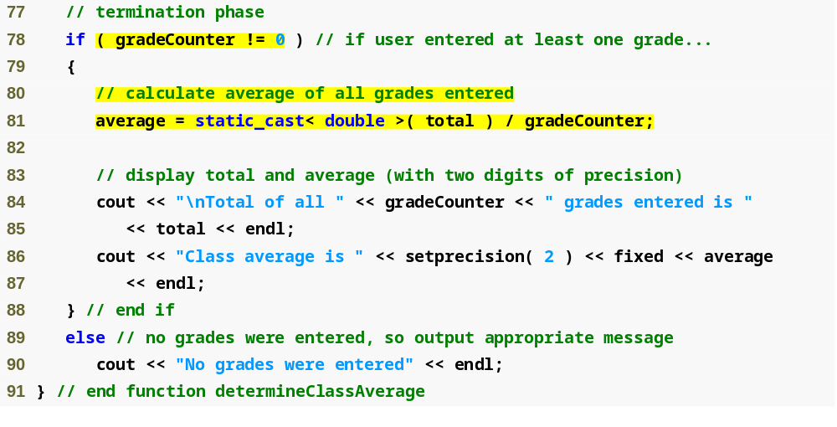
Outline
fig04_13.cpp
(4 of 4)
Calculate average grade using static_cast< double > to perform explicit conversion

Slide 37
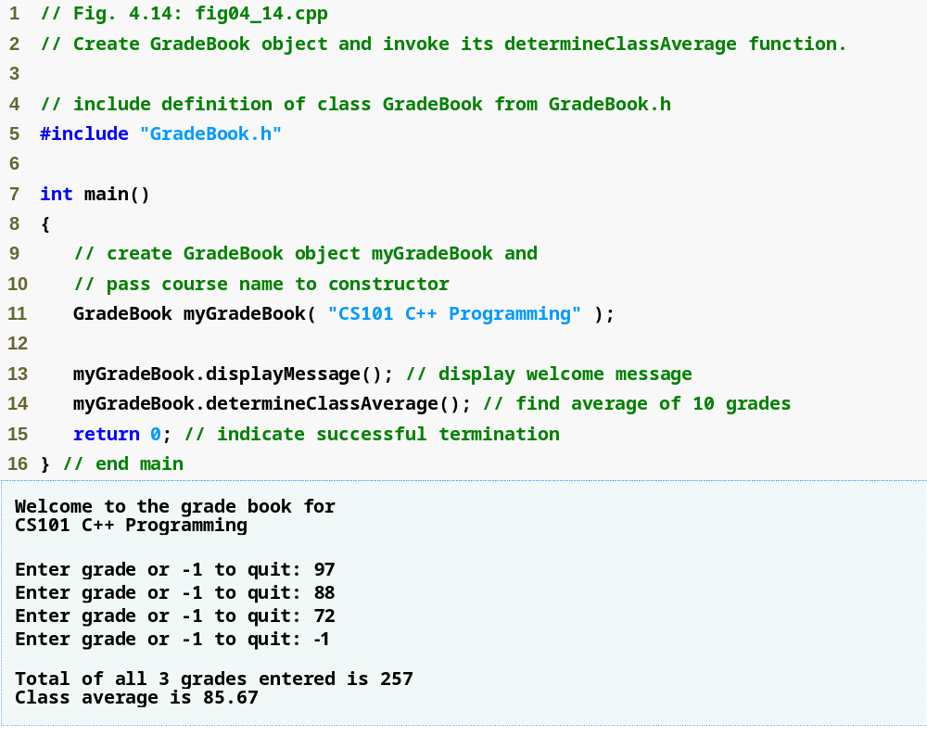
Outline
fig04_14.cpp
(1 of 1)

Slide 38
Good Programming Practice 4.7
Prompt the user for each keyboard input. The prompt should indicate the form of the input and any special input values. For example, in a sentinel-controlled loop, the prompts requesting data entry should explicitly remind the user what the sentinel value is.

Slide 39
Common Programming Error 4.12
Using floating-point numbers in a manner that assumes they are represented exactly (e.g., using them in comparisons for equality) can lead to incorrect results. Floating-point numbers are represented only approximately by most computers.

Slide 40
4.9 Formulating Algorithms: Sentinel-Controlled Repetition (Cont.)
Unary cast operator
  Creates a temporary copy of its operand with a different data type
    Example
      static_cast< double > ( total )
        Creates temporary floating-point copy of total
  Explicit conversion
Promotion
  Converting a value (e.g. int) to another data type (e.g. double) to perform a calculation
  Implicit conversion

Slide 41
Common Programming Error 4.13
The cast operator can be used to convert between fundamental numeric types, such as int and double, and between related class types (as we discuss in Chapter 13, Object-Oriented Programming: Polymorphism). Casting to the wrong type may cause compilation errors or runtime errors.

Slide 42
4.9 Formulating Algorithms: Sentinel-Controlled Repetition (Cont.)
Formatting floating-point numbers
  Parameterized stream manipulator setprecision
    Specifies number of digits of precision to display to the right of the decimal point
    Default precision is six digits
  Nonparameterized stream manipulator fixed
    Indicates that floating-point values should be output in fixed-point format
      As opposed to scientific notation (3.1 × 10³)
  Stream manipulator showpoint
    Forces decimal point to display

Slide 43
4.11 Assignment Operators
Assignment expression abbreviations
  Addition assignment operator
    Example
      c = c + 3; abbreviates to c += 3;
Statements of the form
    variable = variable operator expression;
  can be rewritten as
    variable operator= expression;
Other assignment operators
  d -= 4 (d = d - 4)
  e *= 5 (e = e * 5)
  f /= 3 (f = f / 3)
  g %= 9 (g = g % 9)

Slide 44
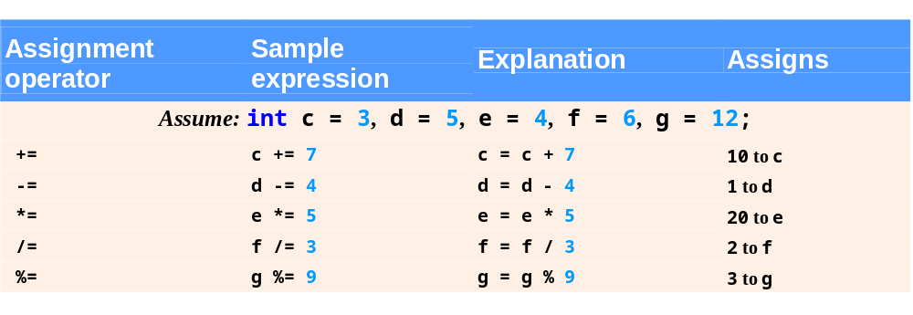
Fig. 4.19 | Arithmetic assignment operators.

Slide 45
4.12 Increment and Decrement Operators
Increment operator ++
  Increments variable by one
    Example
      c++
Decrement operator --
  Decrement variable by one
    Example
      c--

Slide 46
4.12 Increment and Decrement Operators (Cont.)
Preincrement
  When the operator is used before the variable (++c or --c)
  Variable is changed, then the expression it is in is evaluated using the new value
Postincrement
  When the operator is used after the variable (c++ or c--)
  Expression the variable is in executes using the old value, then the variable is changed

Slide 47
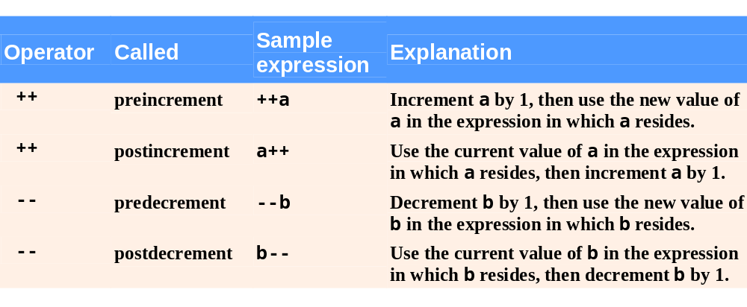
Fig. 4.20 | Increment and decrement operators.

Slide 48
Good Programming Practice 4.8
Unlike binary operators, the unary increment and decrement operators should be placed next to their operands, with no intervening spaces.

Slide 49
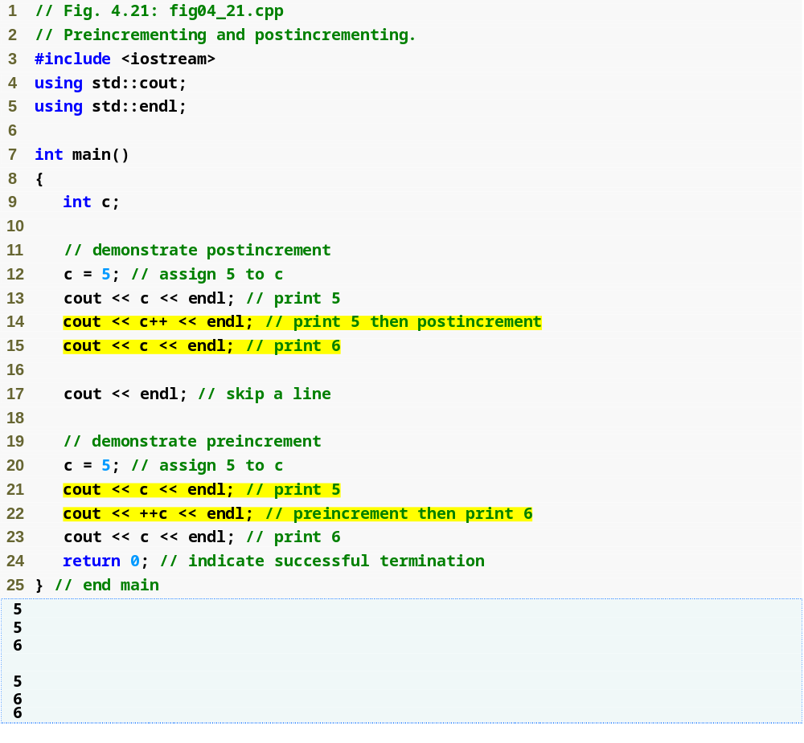
Outline
fig04_21.cpp
(1 of 1)
Postincrementing the c variable
Preincrementing the c variable

Slide 50
4.12 Increment and Decrement Operators (Cont.)
If c = 5, then
  cout << ++c;
    c is changed to 6
    Then prints out 6
  cout << c++;
    Prints out 5 (cout is executed before the increment)
    c then becomes 6

Slide 51
4.12 Increment and Decrement Operators (Cont.)
When variable is not in an expression
  Preincrementing and postincrementing have same effect
    Example
      ++c;
      cout << c;
      and
      c++;
      cout << c;
      are the same

Slide 52
Common Programming Error 4.14
4Attempting to use the increment or decrement operator on an expression other than a modifiable variable name or reference, e.g., writing ++(x + 1), is a syntax error.

Slide 53
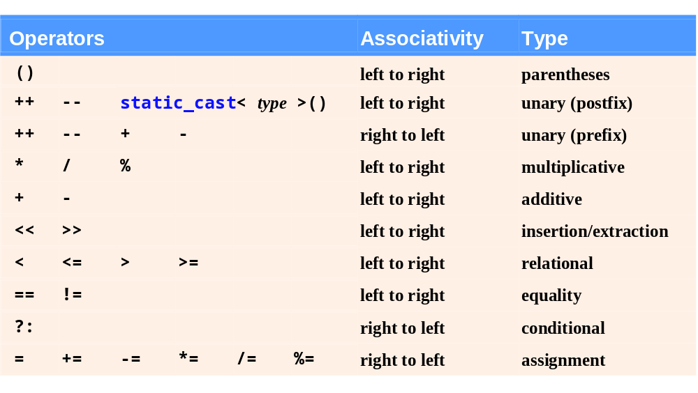
Fig. 4.22 | Operator precedence for the operators encountered so far in the text.

Slide 54
4.13 (Optional) Software Engineering Case Study: Identifying Class Attributes in the ATM System
Identifying and modeling attributes
  Create attributes and assign them to classes
    Look for descriptive words and phrases in the requirements document
    Each attribute is given an attribute type
    Some attributes may have an initial value
    Example
      userAuthenticated : Boolean = false
        Attribute userAuthenticated is a Boolean value and is initially false

Slide 55
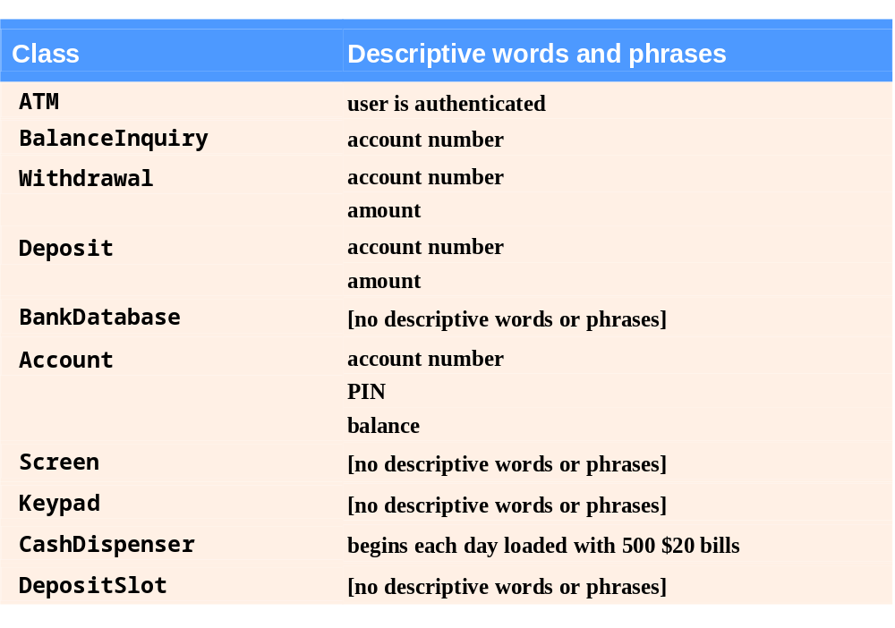
Fig. 4.23 | Descriptive words and phrases from the
ATM requirements.

Slide 56
4.13 (Optional) Software Engineering Case Study: Identifying Class Attributes in the ATM System (Cont.)
Identifying and modeling attributes (Cont.)
  Some classes may end up without any attributes
    Additional attributes may be added later on as the design and implementation process continues
  Class-type attributes are modeled more clearly as associations

Slide 57
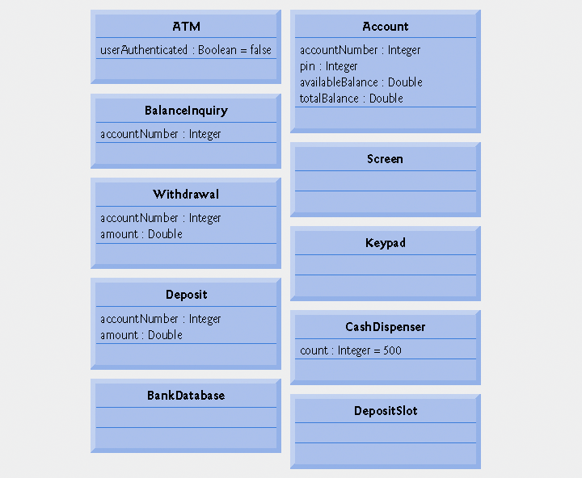
Fig. 4.24 | Classes with attributes.

Slide 58
Software Engineering Observation 4.8
At early stages in the design process, classes often lack attributes (and operations). Such classes should not be eliminated, however, because attributes (and operations) may become evident in the later phases of design and implementation.

